Slide 1
5G networks for smart healthcare: 5G enabled emergency vehicle communication system
S M Abu Adnan Abir (101244043)
Ikshit Jadav (101258088)
SYSC 5804: 5G Networks
Instructor: Professor Jun Steed Huang
Teaching Assistant: Mohammed Abuibaid

Slide 2

Smart Healthcare
Smart healthcare refers to the integration of advanced technologies and digital innovations into the healthcare industry to improve patient care, optimize operational efficiency, and reduce costs.

Slide 3
Smart healthcare
Wearable devices
Telemedicine
Electronic health records (EHRs)
Artificial Intelligence (AI)
Internet of Things (IoT)
Blockchain
3D printing

Slide 4
Healthcare 5.0 framework

Slide 5
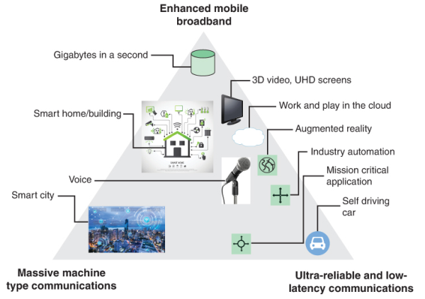
5G technology
Higher data rates, more connections per square inch, and a wider variety of applications are all features of 5G.

Slide 6
key features of 5G
High-speed data transfer
Low latency
Increased bandwidth
Improved network coverage
Network slicing
Improved security

Slide 7
Challenges of 5G Technology in Healthcare
High Cost of Communication Service for Telesurgery
Lack of Interoperability
Power Consumption and Cost of IoT Devices
Cybersecurity Risks

Slide 8

5G enabled emergency vehicle communication system

Slide 9
Identifying the fastest path to reach the incident area

Slide 10
Using dedicated channel for communication during emergency

Slide 11
Thank you.

